Slide 1

MAJOR PROJECT
ON
CRACKWATCH AI: REAL-TIME RAIL SURFACE CRACK DETECTION USING DEEP CONVOLUTIONAL ARCHITECTURES
DEPARTMENT OF INFORMATION TECHNOLOGY TEEGALA KRISHNA REDDY ENGINEERING COLLEGE
MEDBOWLI, SAROORNAGAR, HYDERABAD
PROJECT GUIDE
MRS.A.JYOSHNA ASSISTANT PROFESSOR
SUBMITTED BY
A.NAGA PRANEETH CH.SAINADH
B.JAYA CHANDRA
22R91A1205
22R91A1223
23R95A1202

Slide 2
CONTENTS
1. Abstract
2. Problem statement
3. Existing System
4. Proposed System
5. Hardware and Software Requirements
6. Modules
7. Architecture Diagram
8. Use case Diagram
9. Class Diagram
10. Activity Diagram
11. Sequence Diagram
12. Outputs
13. Conclusion
14. References

Slide 3


ABSTRACT
Railway rails are continuously exposed to heavy loads and repeated train movements, which result in surface defects over time. Conventional rail inspection methods depend on manual visual inspection, making the process subjective, time-consuming, and prone to human error. To overcome these limitations, this project proposes an automated rail surface defect detection system using Fast Region-Based Convolutional Neural Networks (Fast R-CNN). The system processes rail surface images to automatically identify and localize defect regions. By minimizing human involvement, the proposed approach ensures consistent and objective inspection results. This system improves maintenance efficiency and enables early detection of rail surface damage. Overall, the proposed method enhances railway safety and operational reliability.

Slide 4
PROBLEM STATEMENT
The railway network requires continuous monitoring to maintain safety and prevent accidents caused by structural defects. Traditional manual inspection methods are time-consuming, costly, and prone to human error. Undetected faults such as cracks and surface damage can lead to derailments and major economic losses. Therefore, an automated railway fault detection system using deep learning techniques is required. The system must accurately classify railway track images into defective and non-defective categories while minimizing false negatives. Additionally, it should operate efficiently with limited computational resources and support real-time monitoring applications.

Slide 5

EXISTING SYSTEM
The existing rail inspection system relies on periodic manual visual inspection carried out by trained personnel using basic tools. Inspectors walk along the railway tracks and assess rail surface conditions based on personal experience and predefined guidelines. While this method has been traditionally used, it suffers from several drawbacks. The inspection outcome depends heavily on the inspector’s judgment, leading to inconsistent evaluations. The process is labor-intensive, time-consuming, and limited to surface-level observation, making it difficult to accurately assess defect severity. As railway traffic and operational demands increase, this conventional approach becomes inefficient and increases the risk of undetected defects causing failures.

Slide 6

PROPOSED SYSTEM
The proposed system introduces an automated rail surface defect detection approach using Fast R-CNN, a deep learning–based object detection model. Instead of relying on human judgment, the system analyzes rail surface images to detect and localize defect regions automatically. Images obtained from real railway environments and controlled testing conditions are processed, labeled, and used to train the model. Fast R-CNN performs feature extraction and region-based classification to identify defects with high accuracy. This system provides consistent and objective results, significantly reduces inspection time, and supports predictive maintenance by enabling early detection of rail surface damage.

Slide 7

HARDWARE REQUIREMENTS
Processor : i3 or above
Ram : 4GB or higher
Hard Disk :Minimum 500 GB.
SOFTWARE REQUIREMENTS
Platform
Tools
Web Server
Framework
UML Design
: Python
: PIP
: WSGI
: Django
: Star UML

Slide 8
MODULES
• Data Acquisition.
• Dataset Construction
• Model Implementation
• Training and Testing
• Performance Evaluation

Slide 9

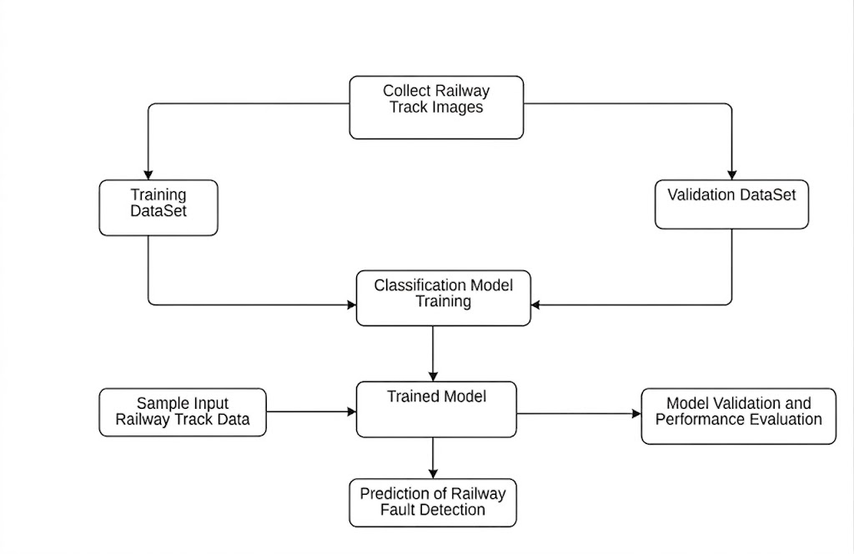
SYSTEM ARCHITECTURE

Slide 10
USECASE DIAGRAM
• A use case diagram is a type of diagram used in Unified Modeling Language (UML).
• A use case diagram is a visual representation of how a user ( actors) interacts with a system.
• The use case diagrams describe what the system does and how the actors use it.
• Use case diagrams describe the high-level functions and scope of a system ( or) high level
overview of the system's functionality from the user's perspective.
• It shows the different ways, a user can use the system and the different roles a user can have

Slide 11
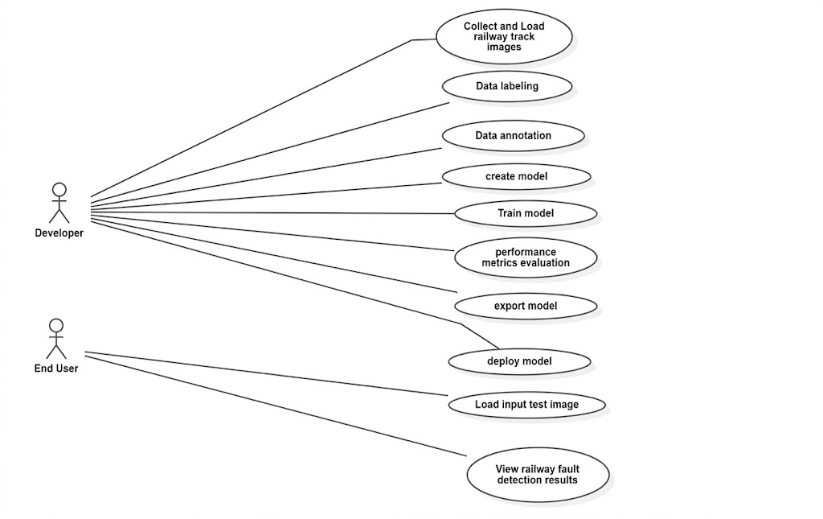

Slide 12
CLASS DIAGRAM
• A Class Diagram shows the structure of a system.It is part of UML (Unified Modeling Language).
• It represents classes, attributes, methods, and relationships .A class is a blueprint of an object.
• Each class has 3 parts:Class Name, Attributes (data/variables) , Methods (functions/actions)
• Attributes store information about the class.
• Methods define what the class can do.
• Classes are connected using relationships.

Slide 13
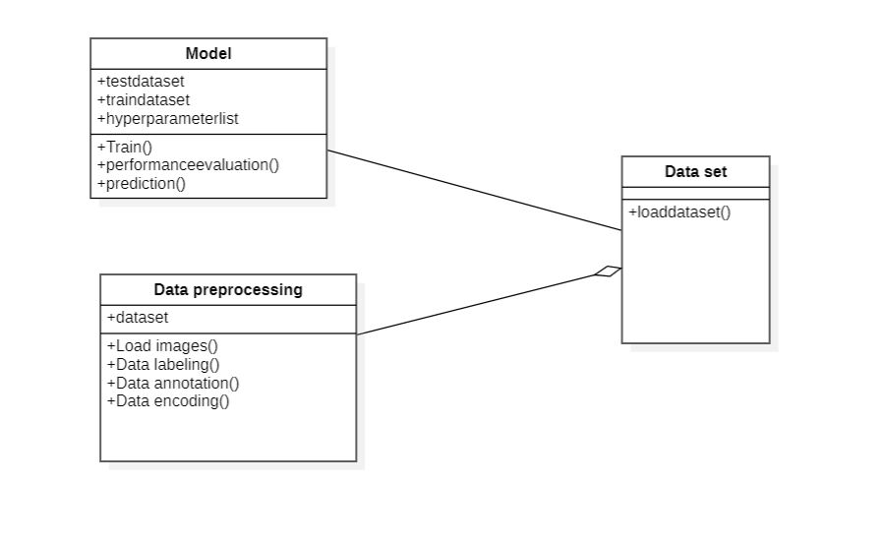

Slide 14
ACTIVITY DIAGRAM
• An Activity Diagram is a UML (Unified Modeling Language) diagram that represents the workflow
( or) the sequence in a system ( or ) a process.
• Activity diagrams are similar to flowcharts because they show the flow between the actions.
• It's like a flowchart hat shows how a process starts, what steps it goes through, and how it ends.
• An activity diagram uses symbols to represent activities, decisions, and the flow of actions

Slide 15
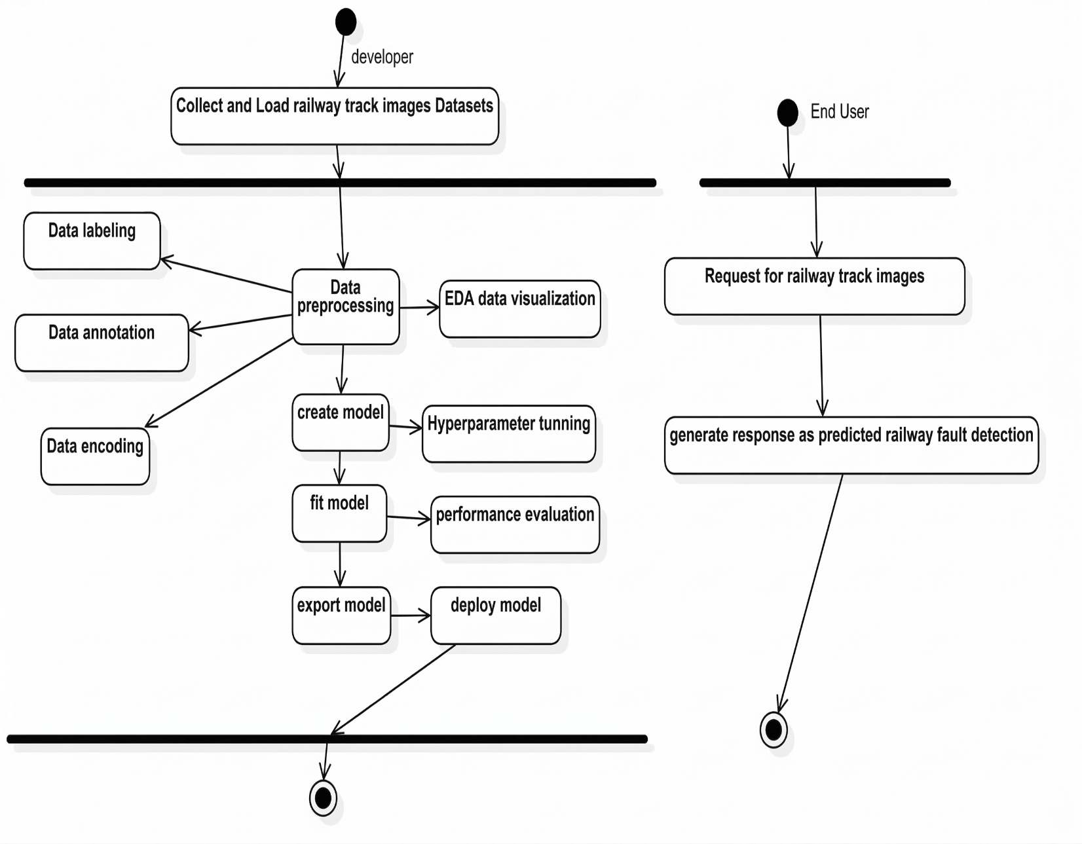

Slide 16
SEQUENCE DIAGRAM
• A sequence diagram is a type of diagram that shows how objects interact with each other in a sequential
order.
• A sequence diagram consists of a group of objects that are represented by lifelines, and the messages
that they exchange over time during the interaction.
• A sequence diagram shows the sequence of messages passed between objects.
• Sequence diagrams can also show the control structures between objects

Slide 17
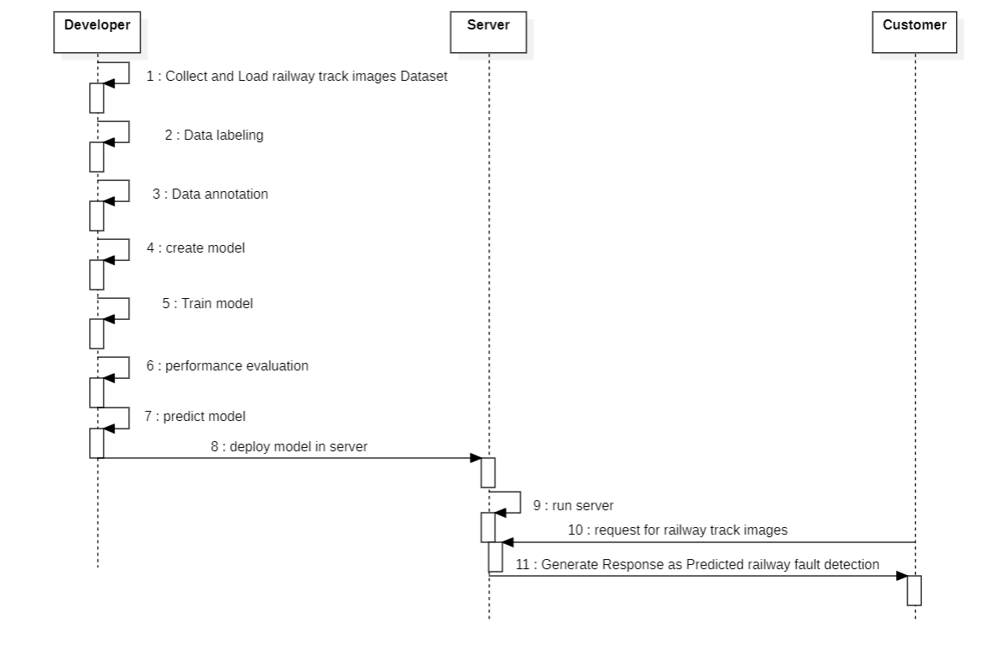

Slide 18
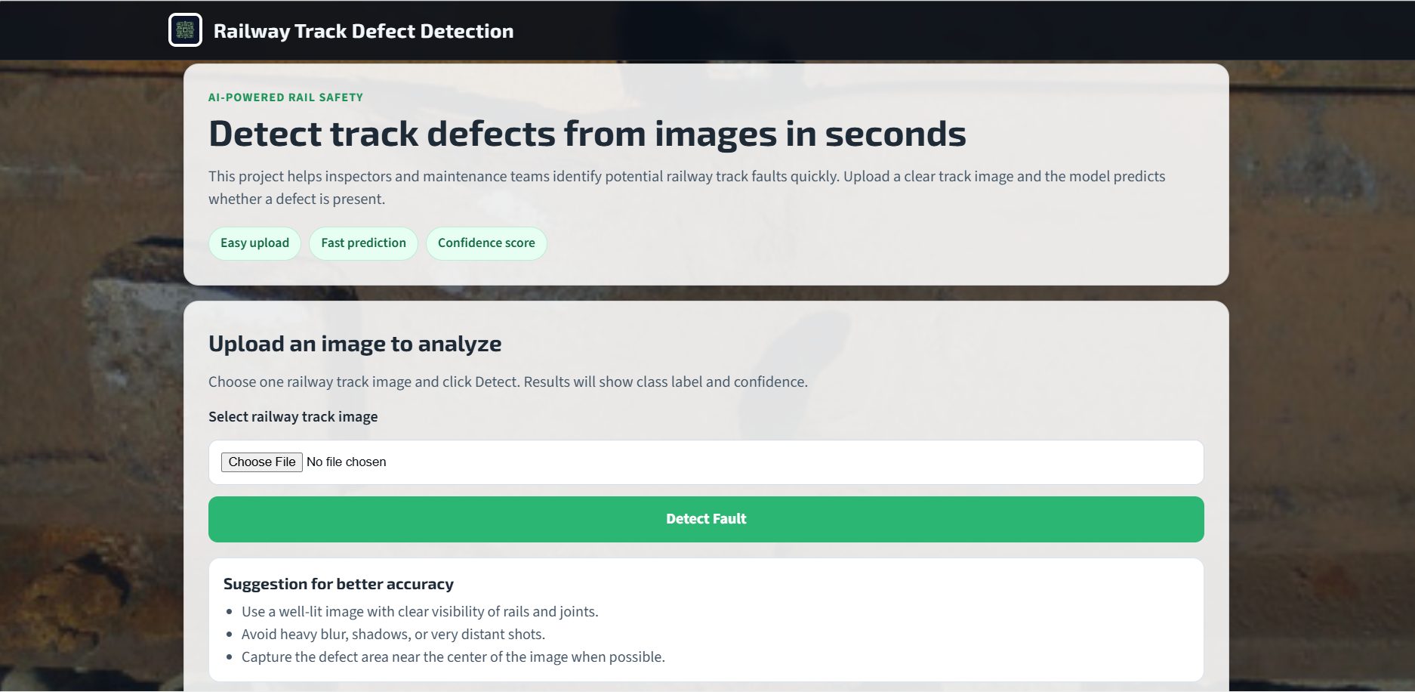
OUTPUTS

Slide 19
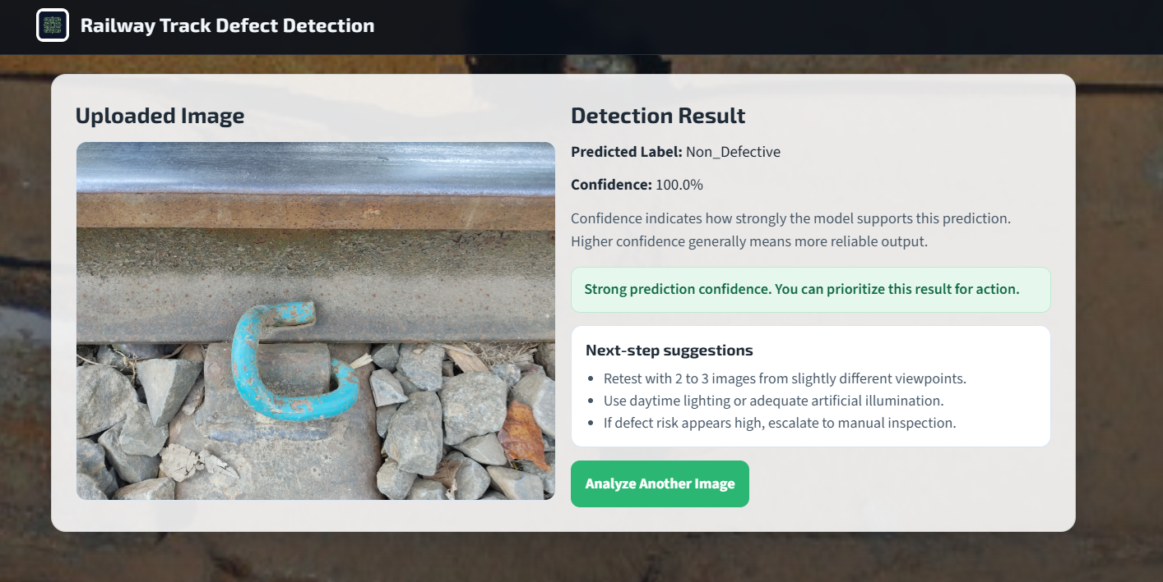

Slide 20
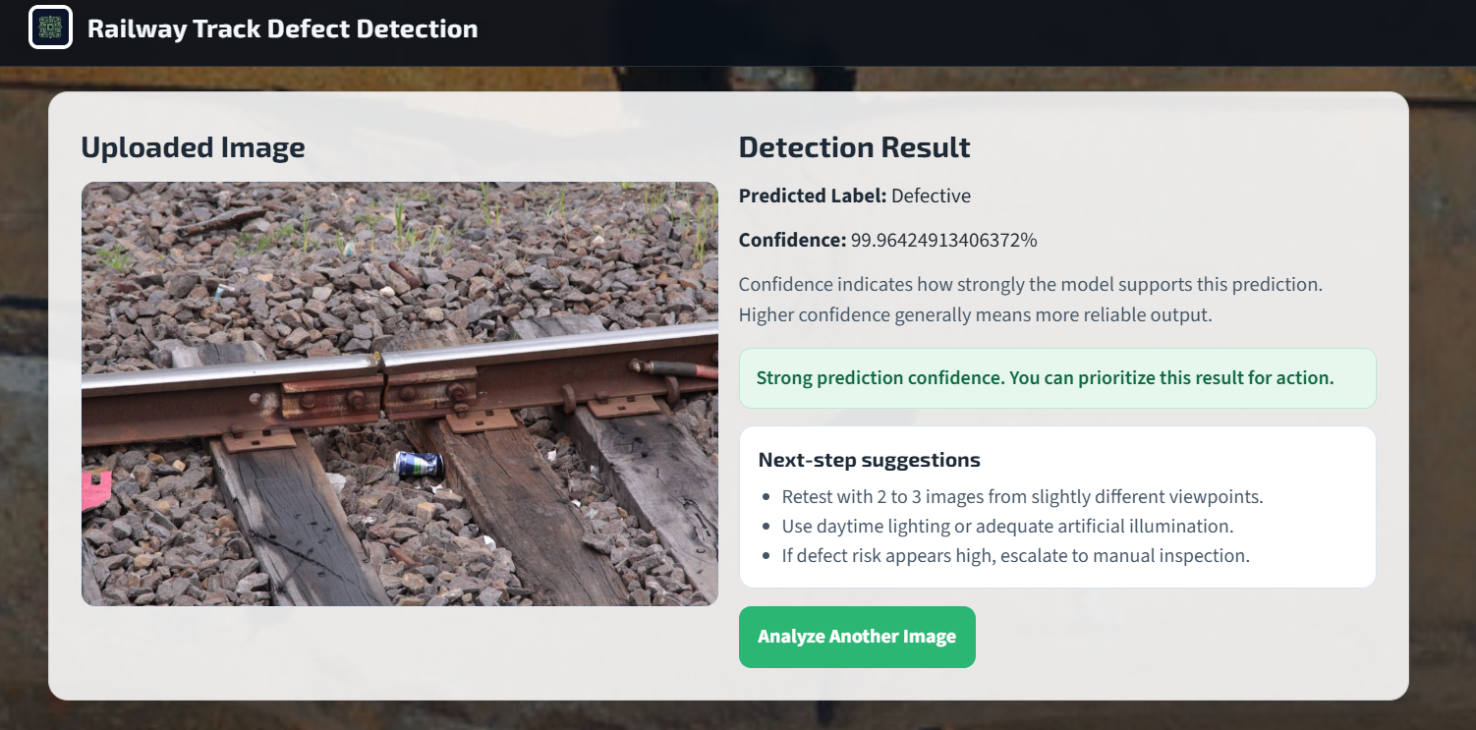

Slide 21
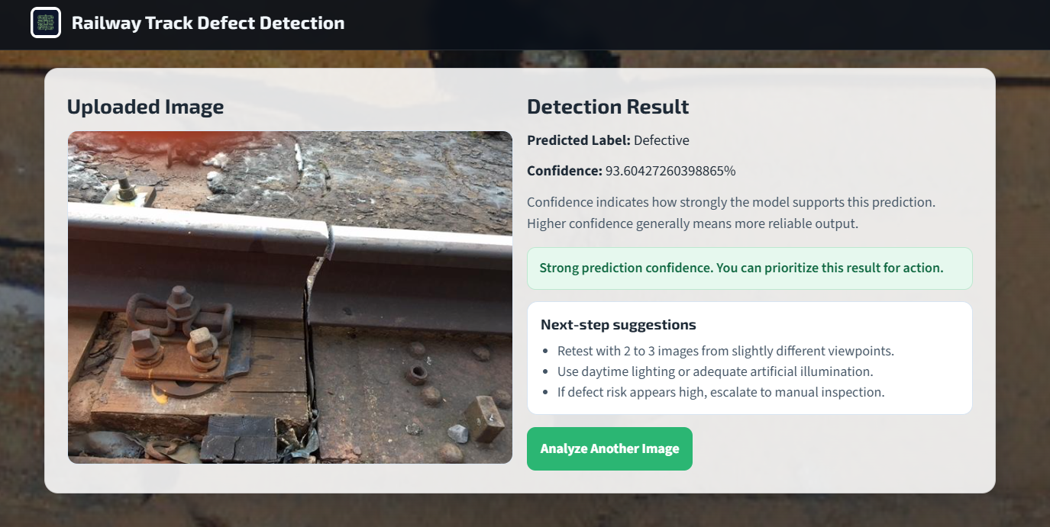

Slide 22
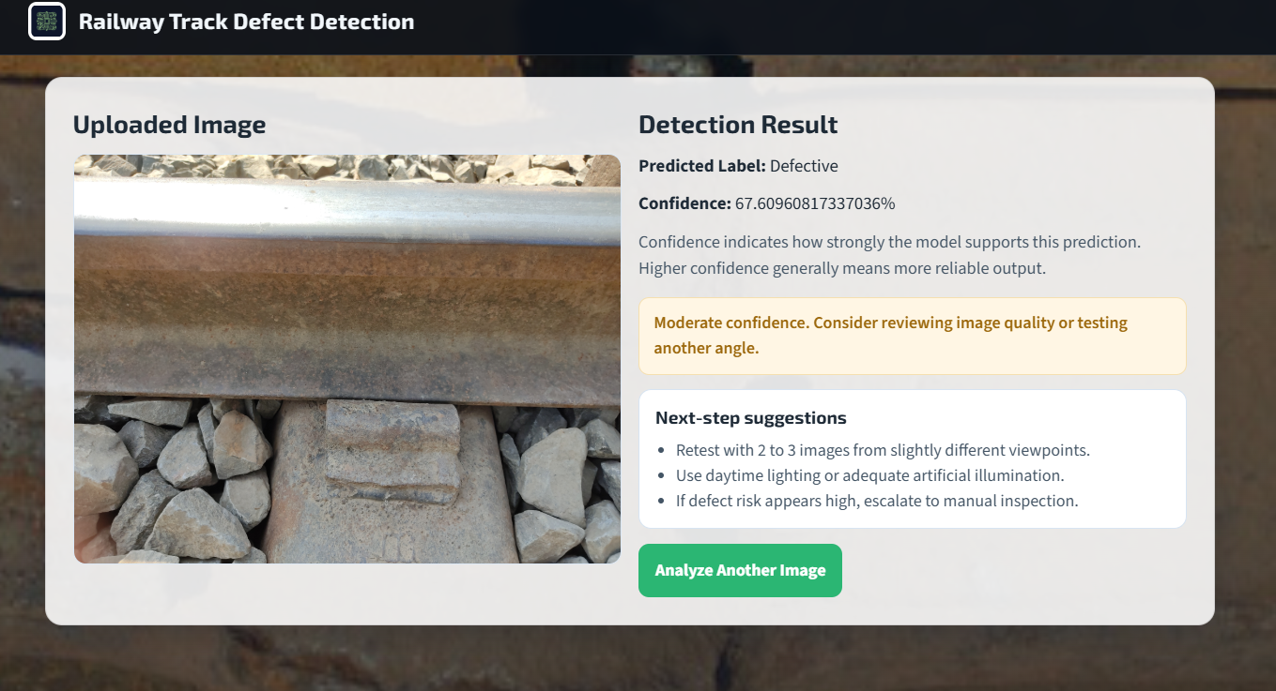

Slide 23
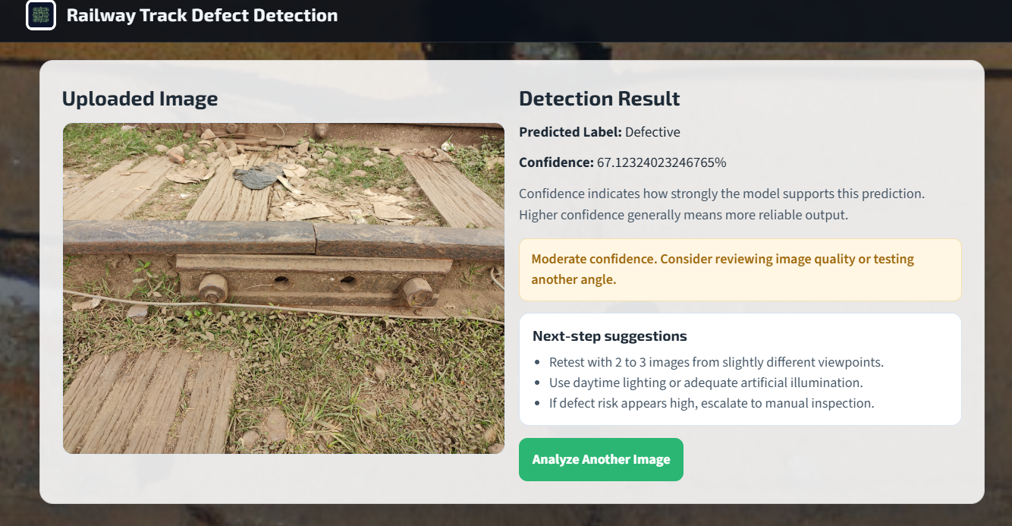

Slide 24
CONCLUSION
This project presents an automated rail surface defect detection system using Fast R-CNN. The proposed approach overcomes the limitations of manual inspection by providing accurate, consistent, and efficient defect detection. The system achieves a high level of detection accuracy, thereby enhancing railway safety and supporting predictive maintenance. The results confirm that deep learning is a reliable and effective solution for modern railway inspection systems.

Slide 25
REFERENCES
Feng J.H. et al., Deep Learning Methods for Rail Surface Defect Detection, IET Electrical Systems in Transportation, 2020.
Zheng D. et al., A Defect Detection Method for Rail Surface and Fasteners Based on Deep Convolutional Neural Network, Computational Intelligence and Neuroscience, 2021.
Wang M. et al., Detection of Surface Defects on Railway Tracks Based on Deep Learning, IEEE Access, 2022.
Rampriya R. et al., Fault Detection and Semantic Segmentation on Railway Track Using Deep Learning, IEEE Access, 2024.

Slide 26
THANK YOU

